Slide 1



Beyond the Ed
Building Research Support for Paramedic Alternatives
Ryan Strum, PhD ACP
Assistant Professor, Dept. of Health Research Methods, Evidence and Impact, McMaster University
CPER Journal Club – September 19, 2024

Slide 2
Outline
Acknowledgements
Emergency Departments
Trends in Paramedicine
Avoidable ED visits
Generating Evidence for Paramedics

Slide 3

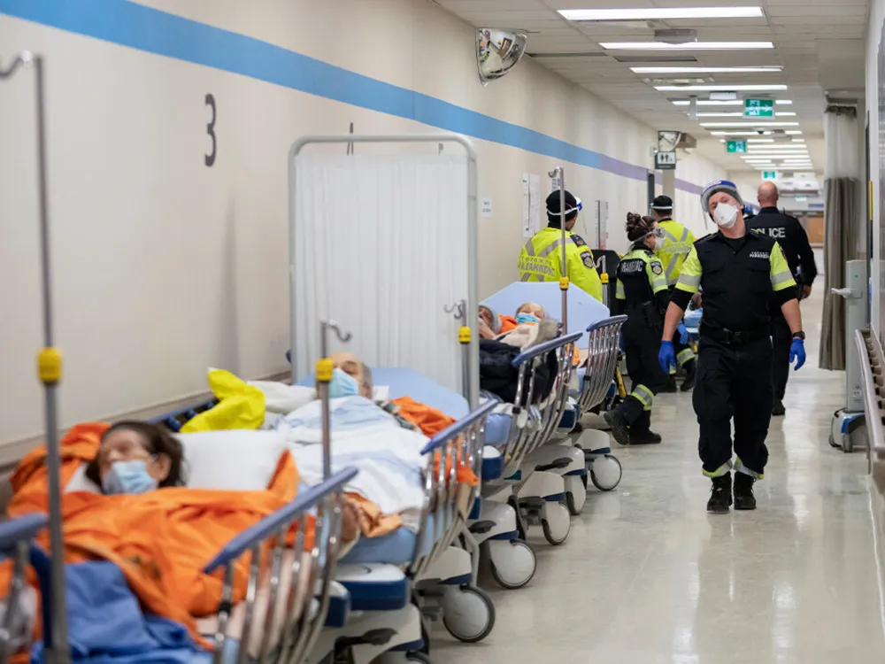
Emergency Departments
What ‘technically’ are emergency departments?
Facilities that provide immediate care for patients with acute injuries and requiring urgent to life-threatening medical attention
A medical emergency is an acute injury or illness that may pose a risk to long-term health or to one’s life if immediate medical attention is not received
  Rapidly diagnose, treat and stabilize patients

Slide 4
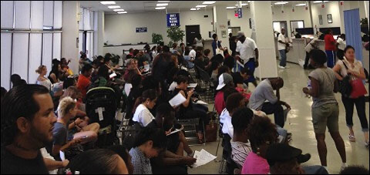

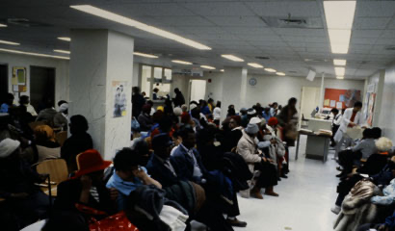
So why do they look like this?
Canada 2023 – 15 million unscheduled ED visits
  A million increase from 2022
2010 to 2019 Canada had a 20% increase
  Not due to population growth alone
EDs used to access the healthcare system, not necessarily for emergency purposes

Slide 5
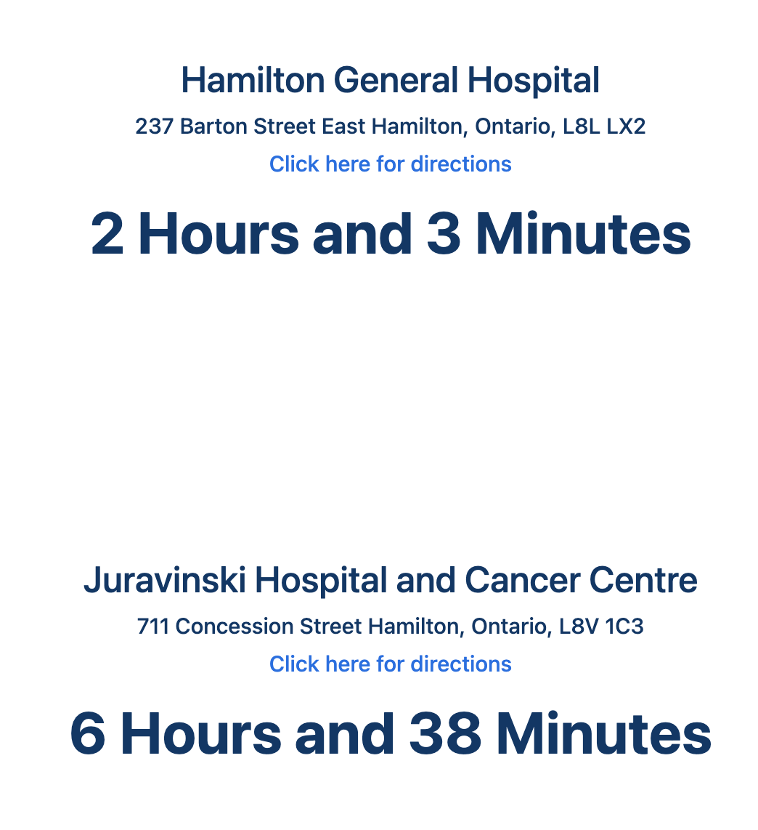
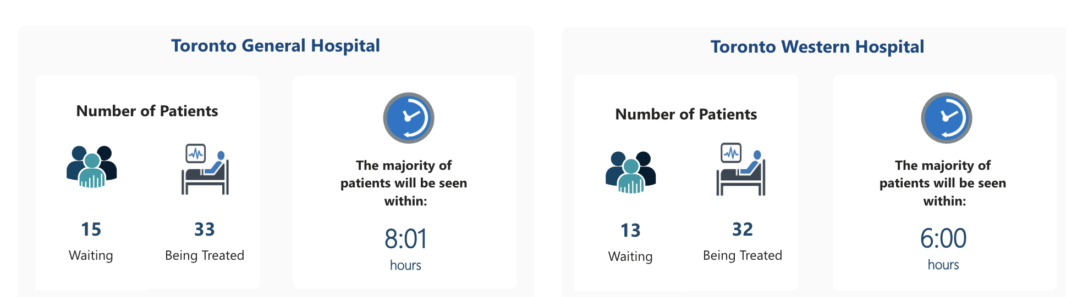


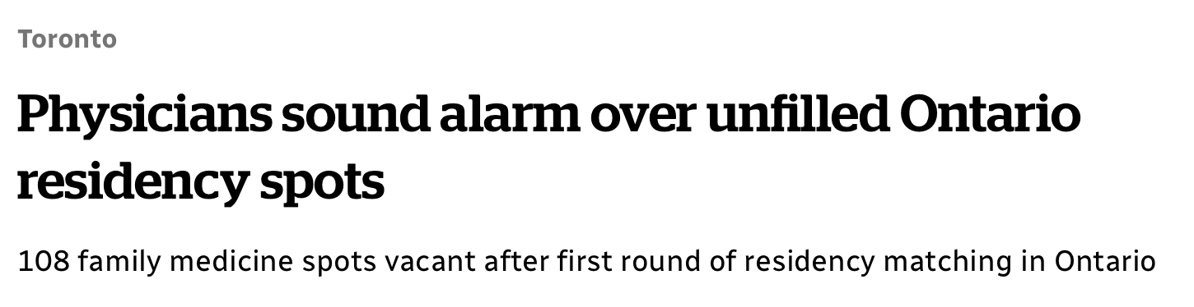
Majority of visits are urgent to non-urgent acuities (CTAS 3-5)
~90% of all patients discharged
ED overcrowding
  Surging patient visitation
  An aging population
  ED boarding
  ED staff burnout/retention
  Decreased primary care*
Wait times are a constant challenge
Family medicine residency spots unfilled
  108 / 560 in 2023
  30 in 2020

Slide 6
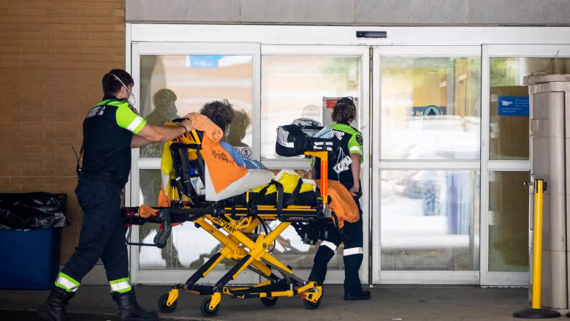
ED Overcrowding Implications
When EDs are overcrowded:
  Mortality in the ED increases 2%
  Care quality is reduced
  Treatment performance declines
  Medical errors increase
  Compliance with medical guidelines decreases
  Cost per visit increases (increased length of stay)
  Patient satisfaction decreases
  Higher staff burnout and stress
When overcrowding is reduced – many of these resolve

Slide 7
Two Questions from here:
Are paramedics observing the same trend?
Are paramedic systems contributing to this overcrowding crisis?

Slide 8
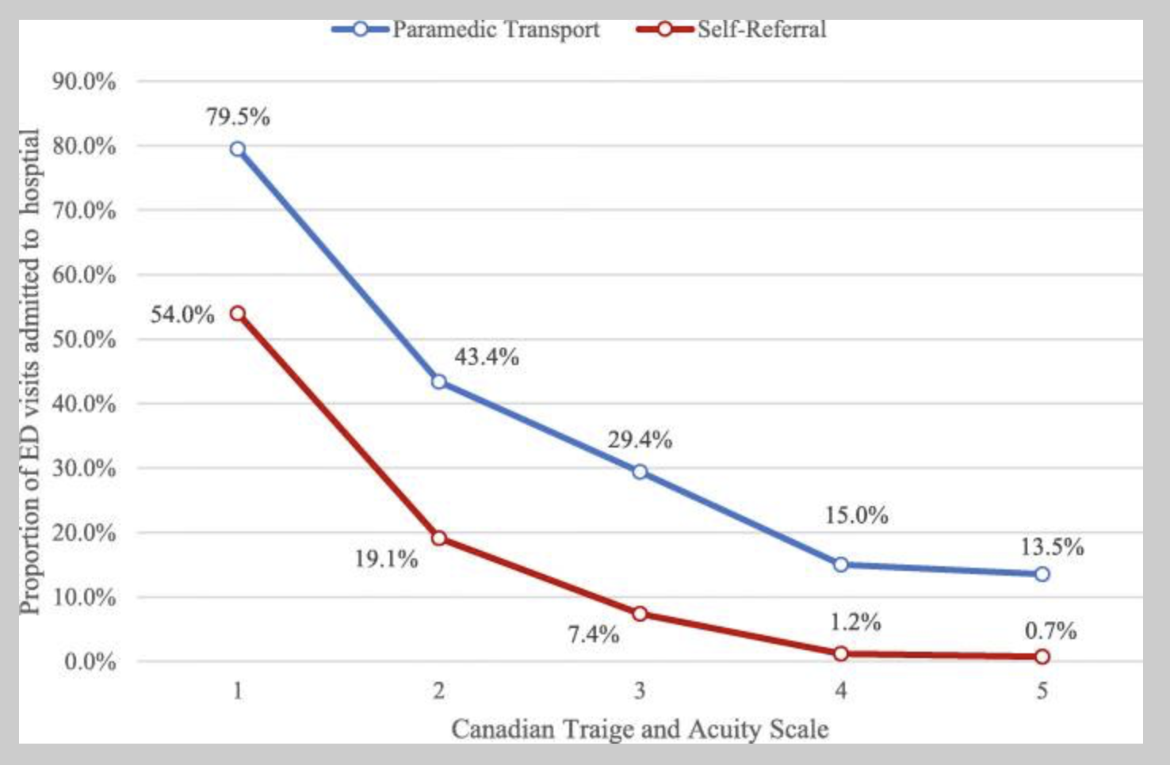
Paramedics Current State
In Ontario, approximately 60% of patients are transported on a CTAS 3 to 5
  Of these, ~30% to 13.5% admitted
~15% of calls are attended but not transported (varies between services)
ALS interventions applied on 20 – 25% of calls
  IV cannula most common (by far)

Slide 9
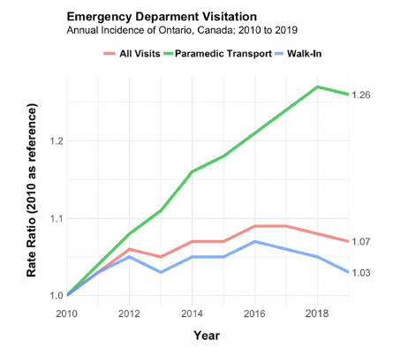
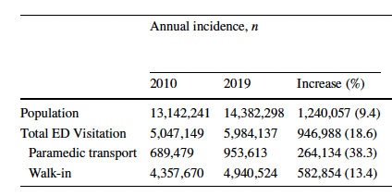

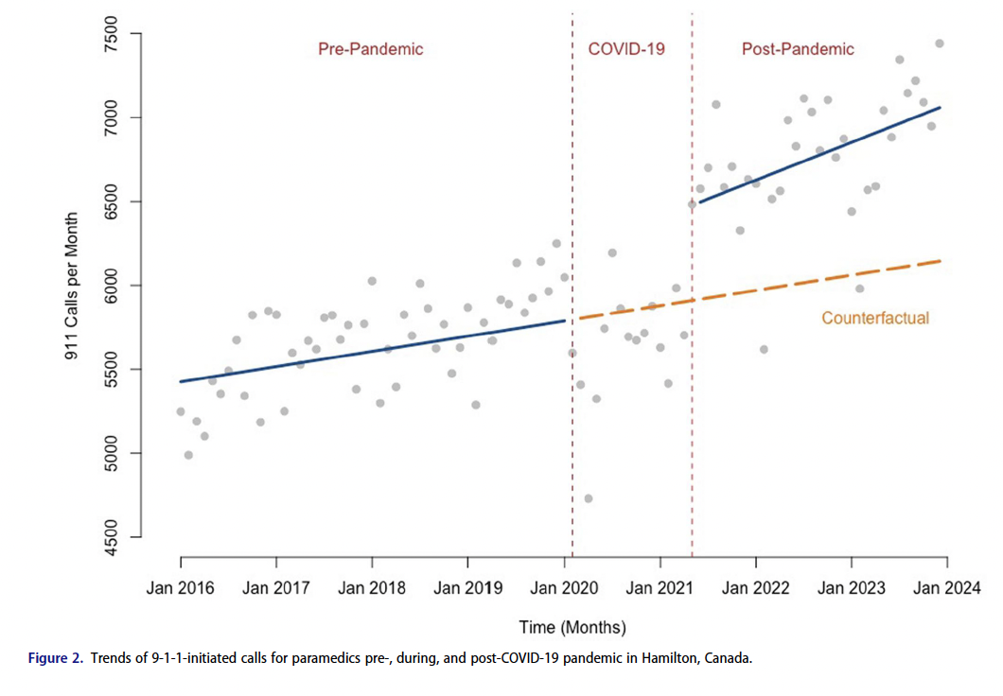
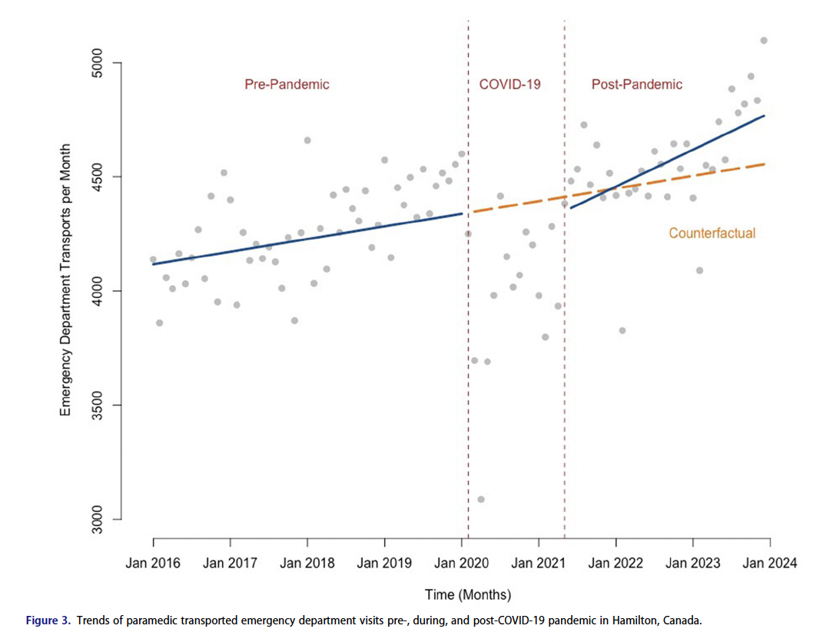
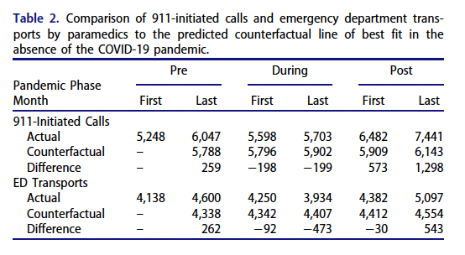
2010 to 2019 in Ontario -> 38% increase in transports
New trend after COVID-19?

Slide 10
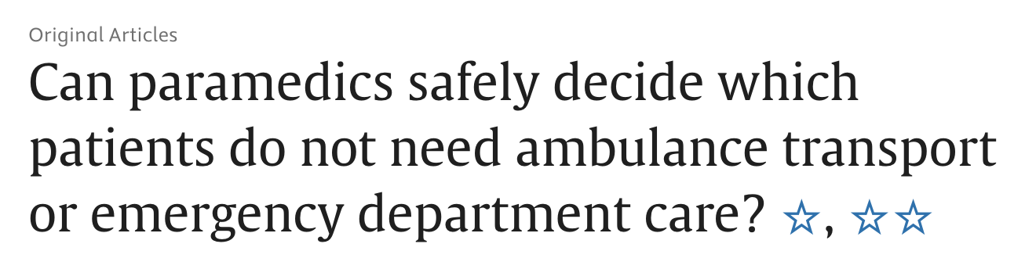
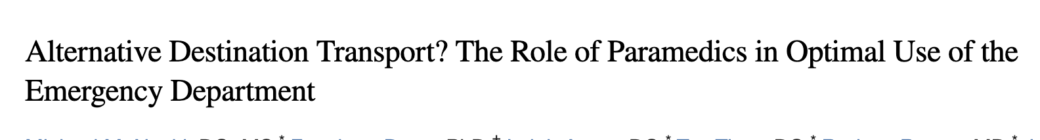
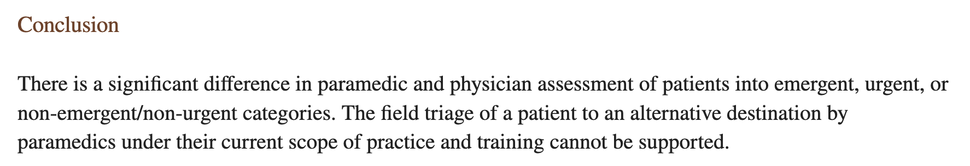
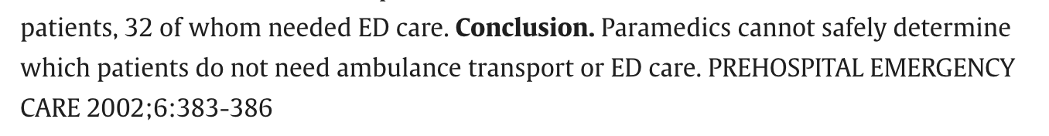
Time for Change
New Care Models
September 2019 – 5 years later
Progress in some cohorts, but not in non-emergent patients
  Why?

Slide 11
Research Support
Identify who these patients are in the ED – sharing today
Who are these patients in the community for paramedics?
How accurate can a clinical guideline for paramedics be?
Do paramedics have the capacity to identify these patients?

Slide 12
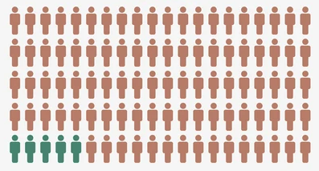
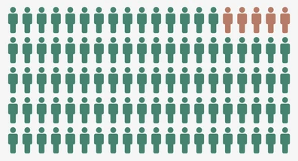
Avoidable ED Visits
ED visits that could have been managed safely in non-ED/subacute care centres
Conditions that if medical attention were delayed for several hours would not increase the likelihood of an adverse outcome
Use classification systems – use criteria to identify these ED visits
  Insights on who patients are, prevalence, trends
But there’s no standard, over 51 methods! →
5%
95%

Slide 13
ED Classifications
Hard to validate (verify their accuracy), lots of time to build
Most common : Ambulatory Care Sensitive Conditions (ACSC)
  Acute or chronic health issues that lead to potentially preventable hospitalizations when not treated in the primary care setting.
  Hospitalizations due to:
    Asthma, CHF, diabetes, COPD, seizures, hypertension, angina

Slide 14
Ambulatory Care Sensitive Conditions
We put ACSC into St. Joe’s ED data – do these look like avoidable ED visits?
If these are the classifications policymakers and researchers are using, no surprise non-emergent patient care models haven’t progressed
Needed a new approach
Age/Sex | CTAS | Diagnosis | ED Intervention | Outcome
64 M | 2 | Atrial fibrillation | Xray of thoracic cavity | Referred to Cardiology and admitted
48 M | 1 | Acute Respiratory Failure (hypoxic) | Ventilation invasive (ETT, PPV) | Referred to Respirology and admitted

Slide 15
Our approach for a Classification
Focus on what was done during the ED visit, a more informative marker than diagnostics to dictate if an ED visit could have been performed in a non-ED centre
  Focused on interventions, instead of diagnostics
  Used a scientific methods to build the classification
  Let experts decide which variables were important
    Used a conservative approach – be sure
  Tested for evidence of external validity
  Compared our classification to others – did we get it right?

Slide 16
The Emergency Department Avoidability Classification (EDAC)
EDAC Classes | Avoidable | Potentially Avoidable | Not Avoidable
Definition | ED visits that could have been managed by subacute primary care | ED visits that could potentially have been managed by subacute primary care | ED visits that could not have been managed by subacute primary care
Age, years | 18 – 70 |  | Not be classified as either Avoidable or Potentially Avoidable
Triage Acuity, CTAS | 4 (Less Urgent) or 5 (Non-Urgent) | 3 (Urgent)
Specialist Consultation in ED | No
Main Physician Intervention, CCI | ~120 Primary care-like interventions
ED Visit Outcome | Discharged
Note: CTAS = Canadian Triage and Acuity Scale, CCI = Canadian Classification of Health Interventions

Slide 17
Cluster-Randomized, Single-Blinded Agreement Study
ED Charts
SJHH Physicians
Researchers
EDAC criteria into ED charts administrative data
Randomly selected 160 (equal from each class)
Each visit randomly assigned to SJHH physicians
Answer: could this visit have been completed in non-ED centre?
Review entire chart independently
Data analysis

Slide 18
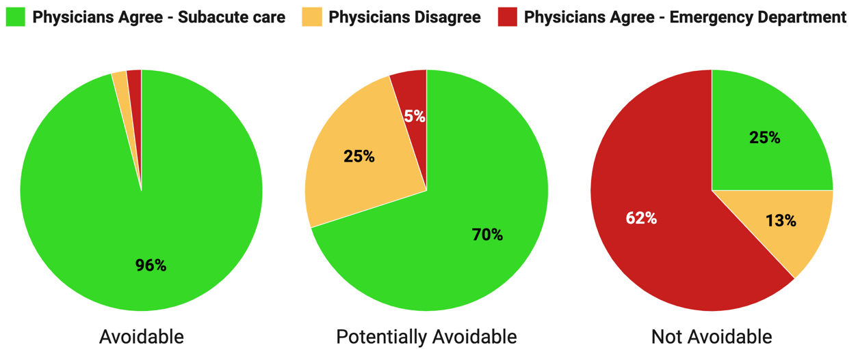
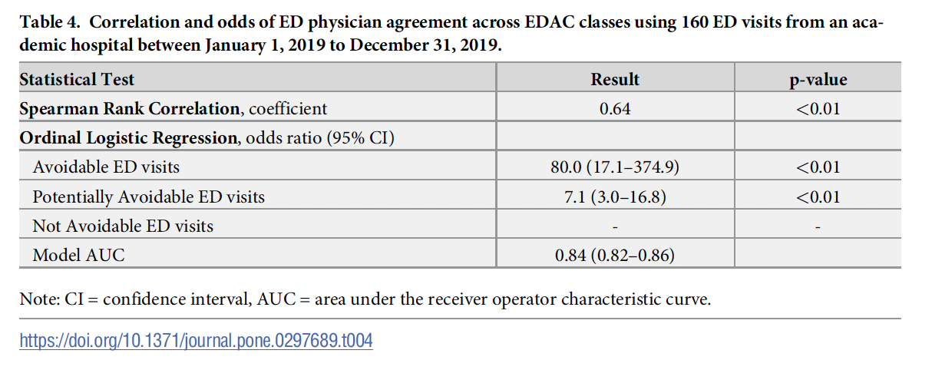
Results

Slide 19
Let’s Revisit those Patient Charts
Class. | Age/Sex | CTAS | Diagnosis | ED Intervention | Outcome
ACSC | 64 M | 2 | Atrial fibrillation | Xray of thoracic cavity | Referred to Cardiology and admitted
 | 48 M | 1 | Acute Respiratory Failure (hypoxic) | Ventilation invasive (ETT, PPV) | Referred to Respirology and admitted
EDAC – Avoidable | 19 F | 5 | Unspecified hand injury | Xray of joint in hand and fingers | Discharged
 | 27 M | 4 | Cellulitis of lower limb | Ultrasound of leg veins | Discharged
EDAC – Pot. Avoidable | 43 F | 3 | Acute stress reaction | Assessment for mental health | Discharged

Slide 20
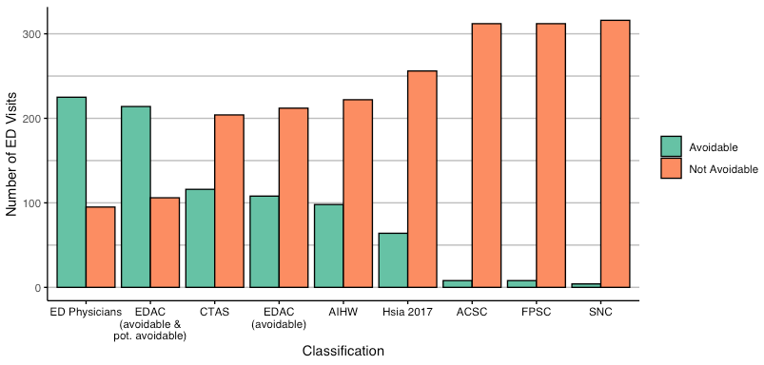
Classifications | Avoidable, n (%) | Not Avoidable, (%)
ED physicians | 225 (70%) | 95 (30%)
EDAC* | 214 (67%) | 106 (33%)
ACSC | 8 (3%) | 312 (97%)
CTAS | 116 (36%) | 204 (64%)

Slide 21

Classifications | Spearman Correlation | OR (95% CI) | Accuracy (%) | Sensitivity (%) | Specificity (%)
EDAC | 0.60 | 19.3 (10.6-35.3) | 83 | 85 | 77
ASCS | 0.10 | 0.4 (0.1-1.7) | 30 | 2 | 96
CTAS | 0.45 | 2.6 (1.1-6.1) | 40 | 38 | 81
Top 5 diagnostic categories:
  Traumatic injury
  Symptoms, signs and abnormal findings (general, no other diagnosis elsewhere)
  Diseases of the muscoskeletal system and connective tissue
  Mental and behavioral disorders
  Diseases of the respiratory system
About 25% of ED visits in our dataset were avoidable – 1 in 4 visits

Slide 22
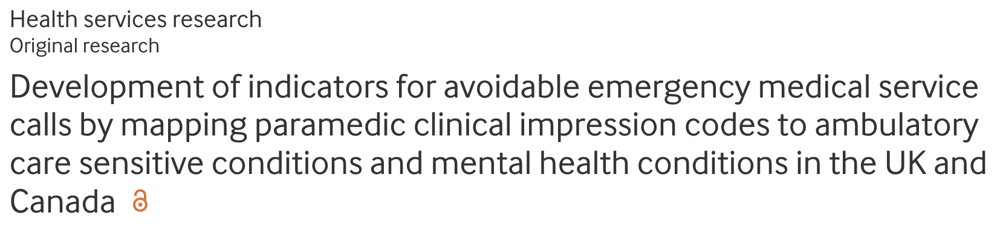
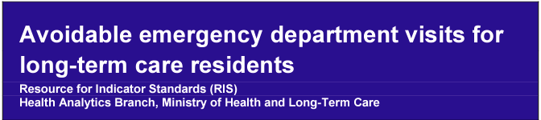
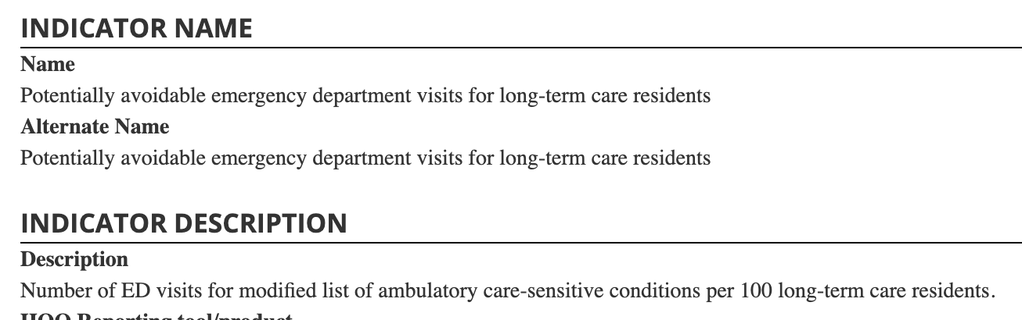
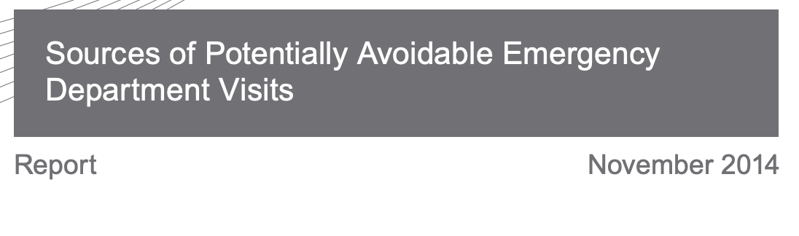
ACSC and Poorly Performing Classifications are Everywhere
Research
Canadian Institutional Reporting
Ontario Health

Slide 23
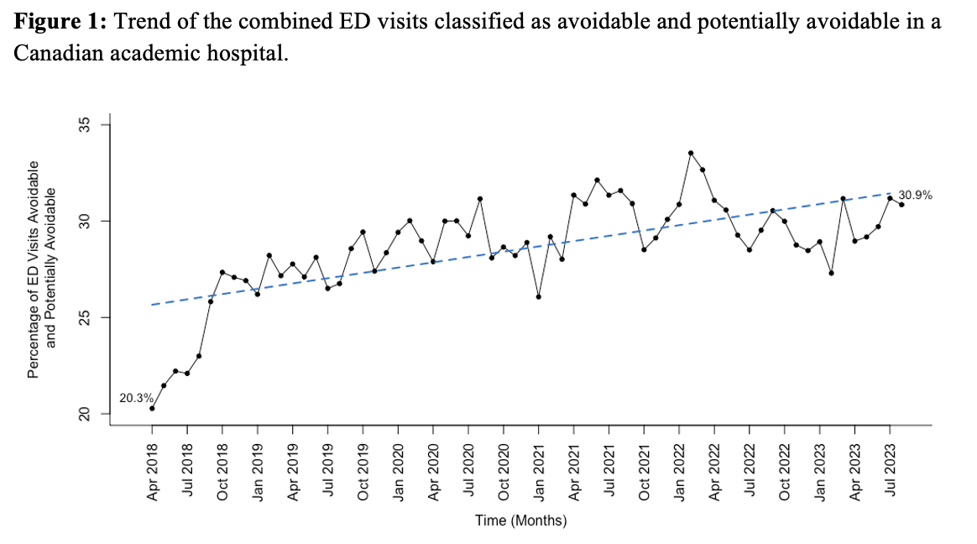
St. Joe’s Emergency Department
Paramedic Transported | Average Time in ED
Avoidable | 4 hours, 22 minutes
Potentially avoidable | 4 hours, 35 minutes
Percent of paramedic transports avoidable or potentially avoidable | 19% (~1 in 5 transports)

Slide 24
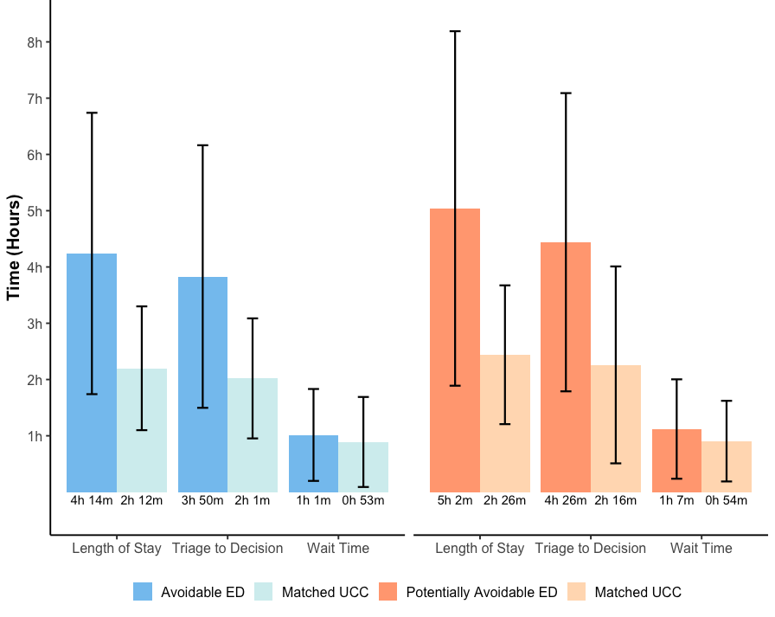
Alternative Destinations
St. Joe’s ED vs. UCC

Slide 25

Or No Transport at all?
Treat and Discharge evaluation – CPER
Safety – was 911 or ED used within following 1, 3, 7 days?
Effectiveness – what are the time savings?
Adoption – are the directives being used?
Expansion – which patient cohorts could be included?

Slide 26
Patients of Avoidable Visits prior to ED Arrival
ED Data
Link to ePCR
Identify avoidable ED Visits
Identify Paramedic Encounters before Transport
Analyze clinical and non-clinical factors, prediction models
Develop Patient Model
We’re here
In new set of ePCRs, use guideline to identify patients
Link to ED
Identify ePCRs likely to have an avoidable ED visit
Analyze whether the guideline was accurate in identifying avoidable ED visits prior to ED arrival
Test Patient Model

Slide 27
The Real Work Begins –
Research can only get you so far
Can paramedics identify this patient cohort?
  If not, is it education needed, or something else?
Which care model do these patients fit into?
Who is liable for a negative patient outcome?
Do paramedic systems have the capacity to build partnerships for nonemergent patients?
  Difficult, time consuming
Would this care model impact call volumes?
  Staffing?
Return on investment for patients not transported to an ED?

Slide 28
Thank you
Questions? Discussion?
strumr@mcmaster.ca
@Ryan_Strum

